Slide 1
Cal Poly
Risk Management
Risk Management Mike Morgan, Risk Manager
Emily Rutherford, Risk Analyst

Slide 2
Risk Management
Risk Management focuses on:
Risks to operations and ownership of property
Injury to persons
Damage or loss of property
Impact to university programs
Liability
Loss of financial resources
University reputation

Slide 3
What does Risk Management do?
Risk Assessments
Insurance (excluding HR benefits)
Driver Safety
Release Agreements
Field Trips
Incident and Accident reporting for liability purposes
Alcohol Service Requests
Unmanned Aircraft (UAS/drone) committee

Slide 4
Risk Assessments
What is a Risk Assessment?
A process to identify threats or hazards that could impact an organization’s business or ability to achieve its goals and objectives.
A key component of the Risk Management Process:
Facilitates the evaluation of probability and severity of such risks,
Provides measures, processes and controls to reduce the impact of these risks to business operations.
Common approaches include: interviews, surveys, risk workshops and brainstorming

Slide 5
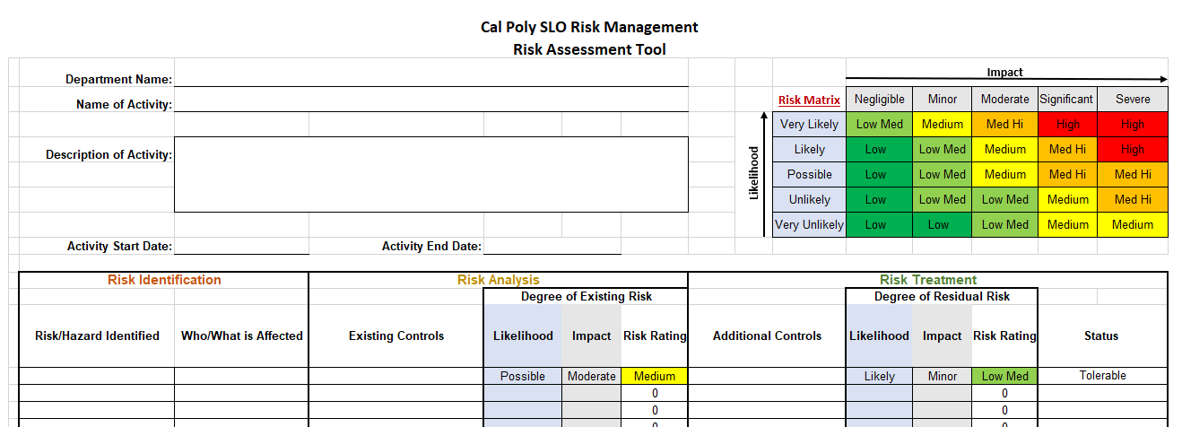
Risk Assessment Tool

Slide 6
Insurance
What insurance does the university have?
Insurance is a financial risk management tool that helps protect against unexpected financial losses.
CSU Risk Management Authority (CSURMA), the risk mitigation pool which allows the university to finance risk across the system.
CSURMA programs include: ​
​Pooled Liability
Property Program
Athletic Injury Medical Expense (AIME)
Pooled Workers' Compensation (EH&S)
IDL/NDI/UI (HR)
Auxiliary Organizations Risk Management Alliance (AORMA​)

Slide 7
Insurance
What are the most common insurance programs?
Self-Insured letter or Certificate of Insurance
Campus Liability
Property Insurance
Special Event Insurance
Foreign Travel Insurance
Auto Physical Damage & Auto Liability
Inland Marine Insurance

Slide 8
Driver Safety
What is the Driver Safety Program?
The Driver Safety Program establishes rules and regulations on driving privileges for anyone who drives on university business.
Only university employees, enrolled student employees and official volunteers over the age of 18 (21 for rentals) meeting minimum criteria may be approved.
State Faculty/Staff authorized for 3 years, student employees 1 year, volunteers shorter of 1 year or volunteer appointment dates.All drivers and driver’s supervisor must complete the application process.
Approved Driver list available on website, updated daily.

Slide 9
Vehicle Accident Reporting
What do I do when there is a vehicle accident?
When to report a vehicle accident
Any university vehicle damaged while driven or parked
Any non-university vehicle damaged while operated on university business
Any vehicle accident where the vehicle is operated by state staff/official volunteers
Required forms to submit to Risk Management within 48 hours of accident
STD 269 Vehicle Accident Data Form (portion given to other party for claims)
STD 270 Report of Vehicle Accident
STD 274 Supervisor’s Report of State Vehicle Accident
Injury accidents, report immediately to Police and EH&S (worker’s comp)
Contact Fleet Services for repairs, Risk Management for APD info

Slide 10
Driver Safety
What is the hold up with my application?
Application processing takes an average of 14 business days.
Deficiencies not fixed, application processing on hold for 10 days
Common deficiencies include:
Training certificate(s) not attached
Copy of front of driver’s license missing
Volunteer form not signed by supervisor or missing
Out-of-state driving record not attached

Slide 11
Release Agreements
What is the Release of Liability Agreement?
Used to:
Inform participant of potential risks associated with activity
Allow individual to voluntarily choose to incur risk
Agreement to indemnify, safe and hold harmless university
Matrix and FAQ available on website
General Counsel updates and distributes form to all 23C
Photo release is administered by UCM

Slide 12
Field Trips
What do we need to know about Field Trips?
Field trips are opportunities for students to engage in learning beyond the classroom.
Course related and faculty/staff member led for educational purposes only.
Field trips expose participants to risks not present in classrooms.
Risk exposure reduced by planning and organizing using the Field Trip guidelines and forms.

Slide 13
Non-Vehicle Incident/Accident Reports
When should I report a non-vehicle incident/accident?
Form STD 268 used to gather information on the incident, file within 48 hours of incident.
Used for property damage and injury/accidents.
Notify police for any emergencies and injuries.
Notify EH&S of employee injuries.
Witness and description of circumstances are critical to the form.
Used for potential claims investigations for the university.

Slide 14
Alcohol Service Requests
Why do I need to fill out an ASR?
Used to ensure that events on campus follow the standards for the use, service, and consumption of alcoholic beverages.
Exception for off campus venues with alcohol license and liquor liability insurance already in place.
CPC can provide ABC license in specific areas on campus, Special Event insurance can provide liquor liability for most events.
E-form that is reviewed by Campus Catering, UPD, RM, and AFD.

Slide 15
UAS Flights
Can I fly a drone at Cal Poly?
Yes, if you have submitted an application to operate a drone on campus and it is approved by the UAS committee.
Operation of UAS is regulated by the FAA and relevant state law, which CP must comply with.
Risks in the operation of drones require committee review, including Flight Readiness Review presented by pilot.
Drone purchases also requires committee approval and are required to register the equipment with the FAA.

