Slide 1
How to use the Student Payroll System
Add Student Job/PayRate/ Supervisor | Enter/Correct Student Time | Enter/Correct Student Time By EmplID/ Department
The use of this function: Add brand new student employees Add new job rows (for existing students) New position numbers (for existing students) Pay Rates (for existing students) Supervisors | The use of this function: Display active student jobs View individual timesheets Enter or Correct time on Timesheets | The use of this function: Similar to Enter/Correct Student Time except: Narrow Selection by individual using EmplID/Department Useful when a Timekeeper has security to view multiple departments
Notes:
I’m not sure if I should delete “The Use of this Function:”

Slide 2
How do I use the Student Payroll System?
Approve Student Time | Approve Student Time By EmplID/Department | Reactivate Student Job
Displays all student timesheets for your department that have hours entered for the current pay period Timesheets will appear here for approval even if the student job was inactivated Approve time entered during the approval period to avoid Late Timesheets | Same functionality as Approve Student Time, except you can narrow your selection by EmplID/Department ID number This is good for Timekeepers that have security to multiple departments | View all student jobs in your department that have been inactivated within the last three years Reactivate student jobs from this screen if all information is updated You may not reactivate a student job if the rate is below minimum wage or the student is no longer eligible to work

Slide 3
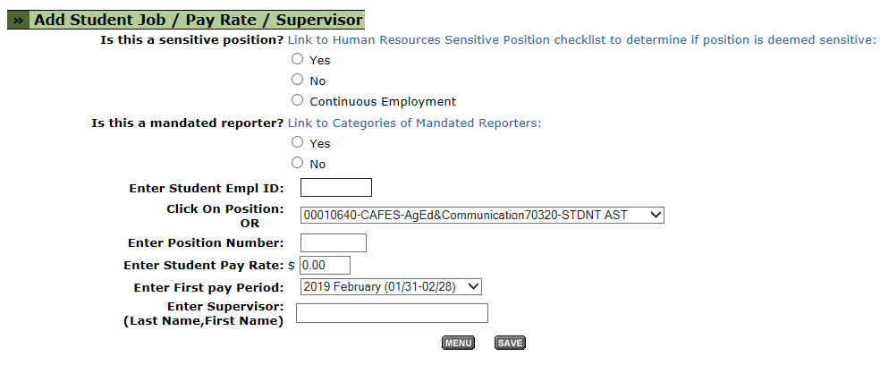
Add Student Job/Pay Rate/Supervisor
Use this screen to add a new student or new job row for a current student employee.
Use this screen to change rate or supervisor
Notes:
Note – When entering Supervisor make sure the formatting is correct. (Last name, no space, first name)

Slide 4
Add Student Job/Pay Rate/Supervisor
Timekeepers may receive error messages for a variety of reasons.
These may include, but not limited to:
Incorrect/partial Employee ID number
Use full Employee ID number including the leading zeroes
Students should provide their Employee ID number upon hire
Employee ID number is required on the Student Employment Request Form (SERF)
Entering an invalid position number
Select one from the drop down or enter it manually. Make sure the position number is eight numbers.
If you don’t know the position number contact the budget analyst for your department or division

Slide 5
Add Student Job/Pay Rate/Supervisor
Entering a pay rate outside of the current pay range for student assistant job classification
You can find the current pay range for student assistant employees on the Student Employment Request Form or the Student Handbook on the Payroll website
Entering the supervisor name without the proper format
Enter name with no spaces as below
Student is enrolled in insufficient number of units
Qualifying units =
Undergraduate: 6 units or more
Graduate: 4 units or more
The academic program needs to be matriculated degree seeking
Notes:
A few more error messages can be the student doesn’t have a social security number entered into PeopleSoft and A FWS position number is being used and the student either does not have an award or the award has not been finalized.

Slide 6
Add Student Job/Pay Rate/Supervisor
Enter the information then click the SAVE button.
Upon saving, you will receive one of the following messages;
If you receive this message the student must go to the Payroll office to complete a new student employee intake before commencing work.
It is required that all employees have an I-9 on file no later than the first day of employment for pay.
The student must bring: Student Employee Request form (SERF), documents to satisfy Federal I-9 requirements and original Social security card to the Payroll Office

Slide 7
Add Student Job/Pay Rate/Supervisor
If you receive this message;
The student has been hired previously and does not need to complete an intake in the Payroll office.
No additional paperwork is required

Slide 8
Enter/Correct Student Time
This screen will display all active student job rows a timekeeper has security to view
To access the students Timesheet select the GO button next to the job row

Slide 9
Enter/Correct Student Time
This page may be printed for approval purposes within the department
The printed online timesheet is never submitted to the Payroll office
Approvals for pay are sent to the Payroll office electronically via the Student Payroll System

Slide 10
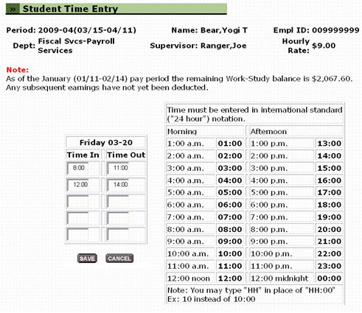
Enter/Correct Student Time
To enter or correct time for a specific day click the desired date
Timekeepers may view, enter or correct a student employee’s time through the Student Time Entry page

Slide 11
Enter/Correct Student Time
To inactivate a student job row click the X button
Student job rows should be inactivated when student is no longer working for the department. This should be reviewed each month and action taken if need be.
Students job rows can be inactivated from both the Enter/Correct Student Time and Enter/Correct Student time by EmplID/Department screens
Inactivating a job will NOT erase hours entered for the current pay period
Job rows with hours entered will appear on the Approve Student Time screen even if it has been inactivated
Notes:
Stress to inactivate student jobs (big problem)

Slide 12
Enter/Correct Student Time
To add a new student job row for an existing active student employee click the plus (+) button
This will take you to the Add Student Job/Pay Rate/Supervisor screen
The Supervisor and position number will auto populate
Rate of pay and Employee ID needs to be entered

Slide 13
Approve Student Time
This screen is were you can view all student positions, active and inactive, that have hours entered for the current pay period
The Timekeeper will submit the online approval for pay during the designated approval period
The dates are listed on this screen for approve/correct time.
The approval dates are posted on the student assistant pay calendar on the payroll website: https://afd.calpoly.edu/payroll/student/pay-dates
Notes:
I don’t know how to get the red arrows off the bottom?

Slide 14
Approve Student Time
To approve a timesheet check the box under ‘Approved’ section and click Save
I recommend that you exit the approval screen and re-enter the screen to make sure the approval saved
It is recommended that a Timekeepers make a print screen of saved approvals for their records
After the pay period has closed the information is no longer available in the Student Payroll System

Slide 15
Approve Student Time
Approved timesheets can’t be edited. To edit an approved timesheet, un-approve the timesheet and save.
Approvals may be done on both ‘Approve Student Time’ and Approve Student Time by EmplID/Department’ screens
All Timekeepers are required to have a back up for approving student payroll in case of absence of the primary student timekeeper
Timekeepers will be reminded of the approval period the morning of the first approval day via email notification
Students who are not approved before the close of the approval period will need to submit a late student timesheet to be paid.

Slide 16
Reactivate Student Job
Timekeepers can view their inactive student positions for approximately the last three years
Can reactivate a student job row if the information has not changed for the student, unless the rate of pay is below the current minimum wage

Slide 17
Reactivate Student Job
Timekeepers can view their inactive student positions for approximately the last three years
Can reactivate a student job row if the information has not changed for the student, unless the rate of pay is below the current minimum wage

