Slide 1
CSUBUY Phase 3: Procure-to-Pay (P2P)
Roadshow: The New Way to Procure & Pay

Slide 2

Agenda
Topic | Presenter
Introduction into CSUBUY | Video
CSUBUY Vision, Objectives, & Benefits | Tu
Timeline | Tu
General Project Update | Tu
Demo: General Navigation & Global Functionality Overview of Forms Create Low Value Requisitions | Tu/Robert/Tonya
Training Overview & Opportunities | Maggie
Go-Live Timing | Maggie
Q&A

Slide 3

Introduction into CSUBUY

Slide 4
CSUBUY P2P: Vision
This is Phase 3 of the CSUBUY Program. It is the implementation of strategic, standardized procurement processes that allows for the elimination of manual touchpoints and steps resulting in efficiencies through automation, risk mitigation and cost savings for the California State University

Slide 5
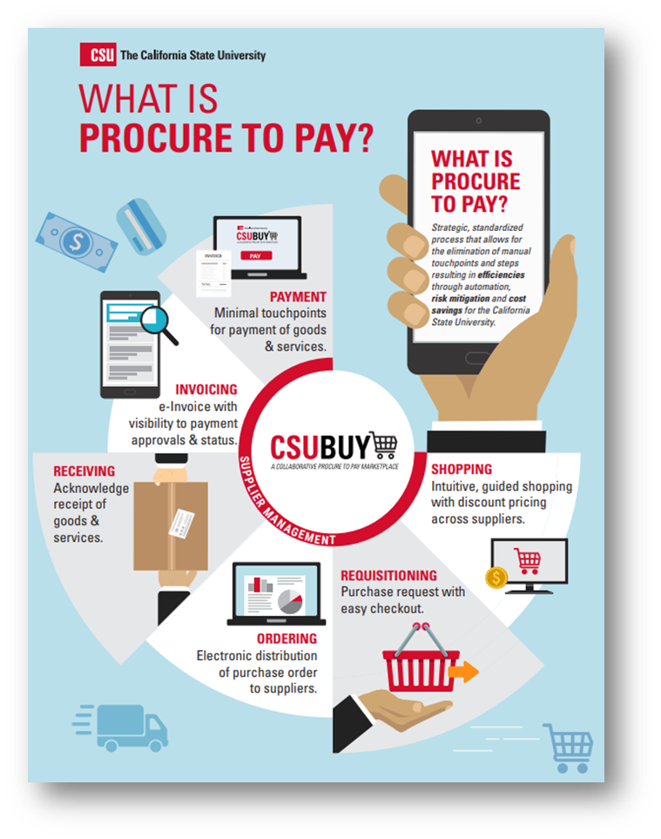

CSUBUY P2P: Objectives
Develop a systemwide platform that integrates disparate data and processes into one streamlined solution
Implement an intuitive and easy to use solution
Create visibility to preferred and sustainable suppliers and guide end users to contracted suppliers.
Drive process efficiency through integration and automation to reduce manual work
Improve compliance and reduce costs

Slide 6





CSUBUY P2P: Benefits
Streamline Procurement and Payment Processes: Consolidate disparate data and processes into a single stream​​lined electronic solution, increasing automation to reduce manual inefficiencies
Improve User Experience: For both suppliers and internal customers, CSUBUY P2P will offer an intuitive and simplified experience.
  Suppliers will benefit from electronic receipt of PO’s and submission of invoices, timely payment and self-service access to check invoice approval and payment status.
  Internal Customers will have easy shopping and check out, access to order and payment status, and a single tool for reconciliation of purchases and payments
Better Data Quality for Decision Making: Improve reporting capabilities, enabling CSU to better identify shared suppliers and leverage negotiating power to drive cost savings.
Increased Visibility: One consolidated P2P system will increase access to data and information for both CSU employees and our suppliers, enabling cross campus visibility in key areas.
Continuous Improvement: CSUBUY P2P drives forward the strategic, systemwide focus on continuous improvement to increase efficiency and effectiveness throughout the organization.​

Slide 7


Project Progress
P2P Campuses
Wave 1 Campuses | Wave 1A - Confirmed | Wave 1B – Pending
Bakersfield Chico Fresno San Bernardino | Los Angeles San Luis Obispo | Sonoma Chancellor’s Office Humboldt
65%
Project Timeline
Notes:
Tu
Q&A
Next Steps – Link to project website, load Kickoff deck on project website

Slide 8
CSUBUY P2P: General Project Update
Recently Completed
In Progress
Coming Soon
Finalized Campus Roadshow Content & Preparation
Completed Integration Testing for: User, Custom Fields, PR Validation, Invoice Validation & PO Export
Finalized Reinforcement Strategy for post Go-Live
Identified Campus Testers for UAT
Analyzed supplier data to identify suppliers to be included in the initial load into CSUBUY
Conduct Campus Roadshows
Test Supplier Sync and Payment Status Integration
Prepare for training for Campus Tester for UAT Testing
Confirmation of value sets including:
  Commodity Codes & Default Account Codes
  Common Value Sets: FOB, PO Types, Direct Pay Types, Payment Terms
  Ship-To & Bill-To Addresses
Confirmation of supplier list for initial load into CSUBUY
Training for UAT testing
Conduct UAT Testing
Develop Training Materials
Define Cutover Strategies including the recommendation for in-flight transactions and reporting
Notes:
Homework assignment

Slide 9
CSUBUY P2P: Configuration Disclaimer
All functional materials, recommendations, and application configurations have been defined by the CSUBUY P2P Core Project Team based on best practice, initial requirements and specific insights from the pilot campus. The configuration shown today is pending Campus Pilot Team and additional Supporting Teams validation and may be subject change.

Slide 10

CSUBUY P2P: Configuration Disclaimer
DEMO

Slide 11


CSUBUY P2P: Demo Details
Activity | Role
General Navigation & Global Functionality: CSUBUY Layout Profile Settings Search | Requester
Overview of Forms | Requester & Approver
User Profile Defaults
Application Values & Approvers

Slide 12
CSUBUY P2P: The Foundation of our Training Approach
Purpose
Educate future CSUBUY Users on changes associated with roles, processes, data, and technology introduced with the rollout of CSUBUY P2P. Our goal is the development of sustainable educational, training, and learning materials to develop individual and organizational capability within the new solution.
Objectives
  Promote a smooth transition for Users from the “old” way of operating to the “new” way of operating
  Facilitate development of skills, capability, and knowledge across all areas of the procurement related activities, via the use of educational activities and tools
  Encourage adoption by providing the right level of knowledge at the right time to the right stakeholder
  Develop a comprehensive, sustainable and accessible knowledge program that makes it simple for Users to find what they need when they need it
  Set up the CSU for long term success post go-live and the ability to support ongoing training needs

Slide 13
CSUBUY P2P: Training Development
The RiseNow Instructional Design Team in partnership with the Core Team and a selection of Campus Subject Matter Experts (SME’s) are working on the training materials for CSUBUY.
All CSUBUY training materials will be reviewed and approved by the CSU SME’s prior to finalizing them for training delivery.

Slide 14
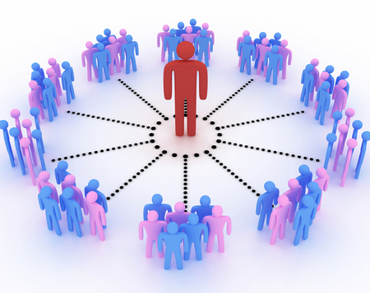
CSUBUY P2P: Train the Trainer
The train-the-trainer model is a training framework that turns campus team members into CSUBUY training subject matter experts who can then teach other members of your campus.
In June 2023, a Train the Trainer series will be hosted, and all pilot campuses have been asked to send at least one resource to this series to become familiar with the training tools and recommended format.
The goal of this series is to enable each campus to deliver training on an ongoing basis as needed following the initial Go Live Readiness trainings.

Slide 15

CSUBUY P2P: Training Experience
START
2
Instructor Led Training: Virtual Training
Duration: Virtual Webinar Options will be provided throughout the months of June – October
Timing: Beginning in late June 2023
1
CSUBUY Roadshows
Timing: February 2023
3
Post Go Live Q&A Workshops – Campus Led
Duration: 30- 60 Minutes, 1x week
Timing: Post Go Live
4
Core Team Hypercare Support Email
Duration: 4 weeks following Go live
Timing: At Go Live / Ongoing
Mandatory
5
Optional
Resource Toolkit
CSUBUY P2P Support Help Desk
Duration: Ongoing
Timing: Beginning in July 2023

Slide 16
CSUBUY: Campus Roll Out
4 weeks before | 3 Weeks Before | 2 Weeks Before | 1 Week Before | Week of Go Live | 1 Weeks After | 2 Weeks After | 3 Weeks After | 4 Weeks After | 5 Weeks After | 6 Weeks After
Go Live Readiness Activities
End User Training Sessions
Go Live
Hyper Care
Transition to Support
Go Live Readiness: Go Live instructions, Training Reminders, Updating Websites And Links, etc.
End User Training: Virtual or In Person Trainings, Sharing Out Training Materials
Hyper Care: Support, Sharing Tips & Tricks, Office Hours, Lessons Learned, etc.…
Transition to Support: Moving CSUBUY Help Desk As Primary Support

Slide 17
CSUBUY P2P: Roll Out Plan
NOTE: There are CFS Configuration activities in preparation for User Acceptance Testing (UAT) that may impact the roll out schedule. The Core Team will keep the Wave 1 Campuses & the CSU Community informed on this progression as we continue to strive to meet the roll out plan.

Slide 18

Q
A
&
Notes:
Tu
Q&A
Next Steps – Link to project website, load Kickoff deck on project website

Slide 19
Appendix
Notes:
Tu

