Slide 1
CSUBUY Phase 3: Procure-to-Pay (P2P)
Roadshow: Townhall

Slide 2

Agenda
Topic | Presenter
Introduction into CSUBUY | Video
CSUBUY Vision, Objectives, & Benefits | Tu
Timeline | Tu
Q&A

Slide 3

Introduction into CSUBUY

Slide 4
CSUBUY P2P: Vision
This is Phase 3 of the CSUBUY Program. It is the implementation of strategic, standardized procurement processes that allows for the elimination of manual touchpoints and steps resulting in efficiencies through automation, risk mitigation and cost savings for the California State University

Slide 5
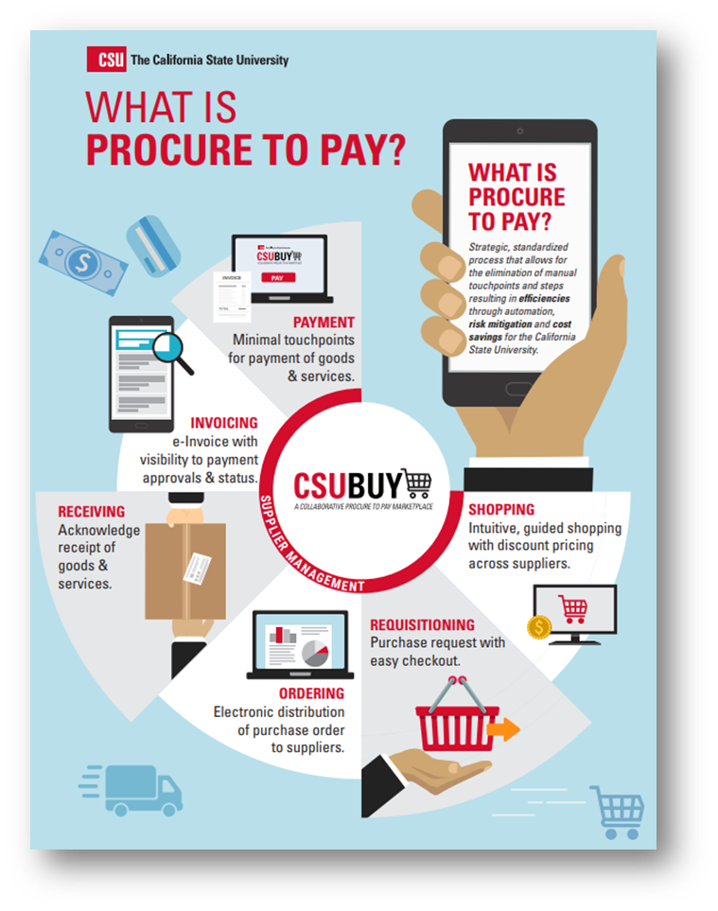

CSUBUY P2P: Objectives
Develop a systemwide platform that integrates disparate data and processes into one streamlined solution
Implement an intuitive and easy to use solution
Create visibility to preferred and sustainable suppliers and guide end users to contracted suppliers.
Drive process efficiency through integration and automation to reduce manual work
Improve compliance and reduce costs

Slide 6





CSUBUY P2P: Benefits
Streamline Procurement and Payment Processes: Consolidate disparate data and processes into a single stream​​lined electronic solution, increasing automation to reduce manual inefficiencies
Improve User Experience: For both suppliers and internal customers, CSUBUY P2P will offer an intuitive and simplified experience.
  Suppliers will benefit from electronic receipt of PO’s and submission of invoices, timely payment and self-service access to check invoice approval and payment status.
  Internal Customers will have easy shopping and check out, access to order and payment status, and a single tool for reconciliation of purchases and payments
Better Data Quality for Decision Making: Improve reporting capabilities, enabling CSU to better identify shared suppliers and leverage negotiating power to drive cost savings.
Increased Visibility: One consolidated P2P system will increase access to data and information for both CSU employees and our suppliers, enabling cross campus visibility in key areas.
Continuous Improvement: CSUBUY P2P drives forward the strategic, systemwide focus on continuous improvement to increase efficiency and effectiveness throughout the organization.​

Slide 7


Project Progress
P2P Campuses
Wave 1 Campuses | Wave 1A - Confirmed | Wave 1B – Pending
Bakersfield Chico Fresno San Bernardino | Los Angeles San Luis Obispo | Sonoma Chancellor’s Office Humboldt
65%
Project Timeline
Notes:
Tu
Q&A
Next Steps – Link to project website, load Kickoff deck on project website

Slide 8
CSUBUY P2P: General Project Update
Recently Completed
In Progress
Coming Soon
Finalized Campus Roadshow Content & Preparation
Completed Integration Testing for: User, Custom Fields, PR Validation, Invoice Validation & PO Export
Finalized Reinforcement Strategy for post Go-Live
Identified Campus Testers for UAT
Analyzed supplier data to identify suppliers to be included in the initial load into CSUBUY
Conduct Campus Roadshows
Test Supplier Sync and Payment Status Integration
Prepare for training for Campus Tester for UAT Testing
Confirmation of value sets including:
  Commodity Codes & Default Account Codes
  Common Value Sets: FOB, PO Types, Direct Pay Types, Payment Terms
  Ship-To & Bill-To Addresses
Confirmation of supplier list for initial load into CSUBUY
Training for UAT testing
Conduct UAT Testing
Develop Training Materials
Define Cutover Strategies including the recommendation for in-flight transactions and reporting
Notes:
Homework assignment

Slide 9

Q
A
&
Notes:
Tu
Q&A
Next Steps – Link to project website, load Kickoff deck on project website

