Slide 2
TOPICS
International Travel Requirements
Request International Travel
Expense International Travel
Hotel and Meal Expense Types
Travel Allowance Itineraries and Reimbursable Limits

Slide 3
International Travel
Requirements
An Approved Request is required before committing any funds for trip
More approvals are required than domestic, including International Center Director and Provost for High Risk travel
Allow at least 60 days for Request approval process
Travel Allowance Itinerary is required
Concur Travel Card is preferred payment method
Hotel and Meal expense types must be claimed as actuals, not a per diem

Slide 5
Request international TRAVEL

Slide 6
International Travel
Request Process
Individual Traveler:
Complete Request in Concur tool¹
Select “International” in Trip Type
Attach .PDF's to Request (required)
Submit for approval
Group or Student Traveler:
1. Must start with Cal Poly International Center
¹ All approvals occur in Concur

Slide 7
request
Expense Check List – All Travel
MAKE SURE TO INCLUDE ALL EXPENSES; CONSIDER:
Airfare
Hotel
Car Rental and Insurance
Registration Fees
Personal Car Mileage
Meals – International, Alaska, Hawaii (international, Alaska, or Hawaii only)
Ground Transportation at destination
Parking
Hospitality, if expecting to host other non-Cal Poly staff or faculty

Slide 8
INTERNATIONAL REQUEST
Check List
Include ALL potential expenses
If personal travel, attach airfare comparison (airfare with and without personal travel)
Attach signed required documents including Foreign Travel Insurance Form and Export Compliance Form. If traveling with family, Release of Liability Form is also required
Regularly check Audit Trail when Request is being routed for approval to ensure ALL proper reviewers are approving the Request
Ready to submit International Request in Concur

Slide 9
INTERNATIONAL REQUEST
APPROVAL FLOW
ACADEMIA
1.
Cost Object Approver
2.
Dept. Head/ Chair
3.
Dean
4.
Exception
Approver
5.
Int’l Center AVP
6.
Provost High Risk travel only
Adds
Dean
Verifies/ Adds
Dean
All approvers are responsible for reviewing all material including PDF before approving

Slide 10
INTERNATIONAL REQUEST
APPROVAL FLOW
ADMINISTRATION
1.
Cost Object Approver
2.
Manager/ Supervisor
3.
Unit or Division Head
4.
Exception
Approver
5.
Int’l Center AVP
6.
High Risk travel Approver
Adds
Unit or Division
Head
Verifies/ Adds
Unit or Division Head
All approvers are responsible for reviewing all material including PDF before approving

Slide 11
International request
Responsibilities
TRAVELER:
Required documents are attached to Request to route for ALL proper approvals
Business and personal travel is clearly indicated
Requested budget only reflects business travel
Upon approval, review the Request’s Audit Trail to ensure ALL proper approvers have reviewed and approved the international Request

Slide 12
International request
Responsibilities
APPROVERS:
COA adds Dean or Unit/Division Head to Approval Flow
Manager/ Supervisor ensure Dean or Unit/Division Head is included in Approval Flow
All approver review all content
Valid business reason for travel
Business and personal travel are clearly indicated ensuring requested budget is only for business travel

Slide 13
EXPENSE REPORT international TRAVEL

Slide 14
international Travel
Expense Report Requirements
When Travel includes Alaska, Hawaii or international destination(s)
A Travel Allowance Itinerary is required for specific expense types
Sets daily allowances for these expense types. Add this BEFORE adding expenses
Breakfast, Lunch, Dinner, and Incidental expense types cannot be used, instead…
Meals & Incidentals – International, Alaska, & Hawaii and U.S. Possessions expense type must be used for all meals and incidentals
Can use this expense type multiple times in one day, as long as total does not exceed daily allowance limit

Slide 15
international expenses
Travel Allowance
Travel Allowance Tabs:
Itinerary: build itinerary by entering time and dates of all stops in your trip, including connecting airports
Expenses and Adjustments: day-by-day, indicate meals provided by others
Reimbursable Expense Summary: Concur calculates daily allowance/limits for hotel and/or meals

Slide 16
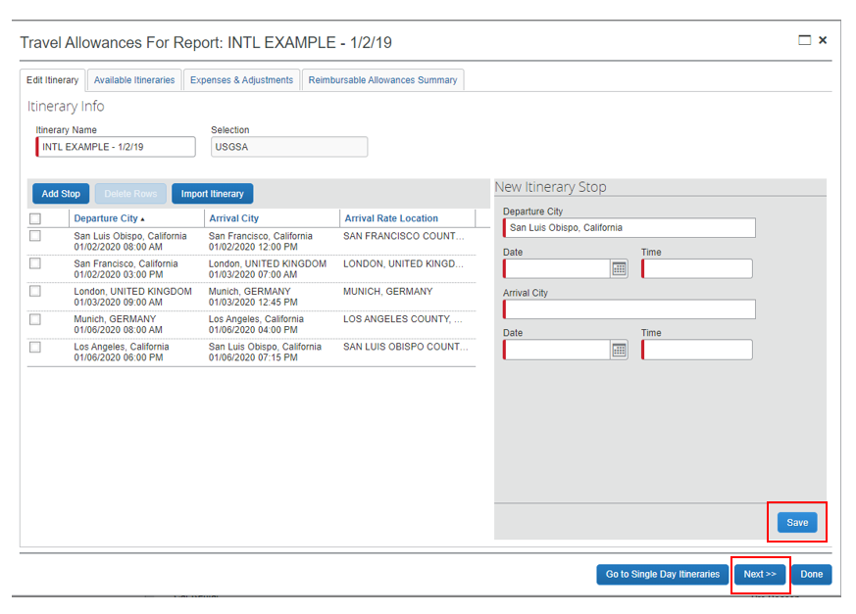
Travel allowance
Itinerary
On the Create New Itinerary tab, enter the first leg of your trip by entering:
Departure City (usually in San Luis Obispo area)
Date (of Departure)
Time (of Departure)
Arrival City (of that leg of the trip)
Date (of Arrival)
Time (of Arrival)
Repeat for each leg of your trip

Slide 17
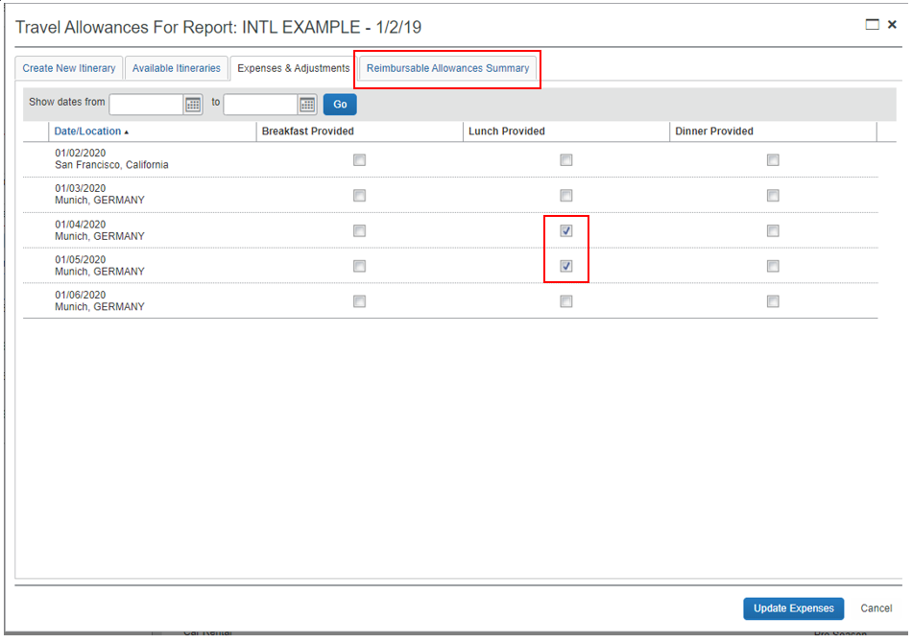
Travel allowance
Expense and Adjustments
All travel dates appear
Each day, check all meals that were provided to you during the trip

Slide 18
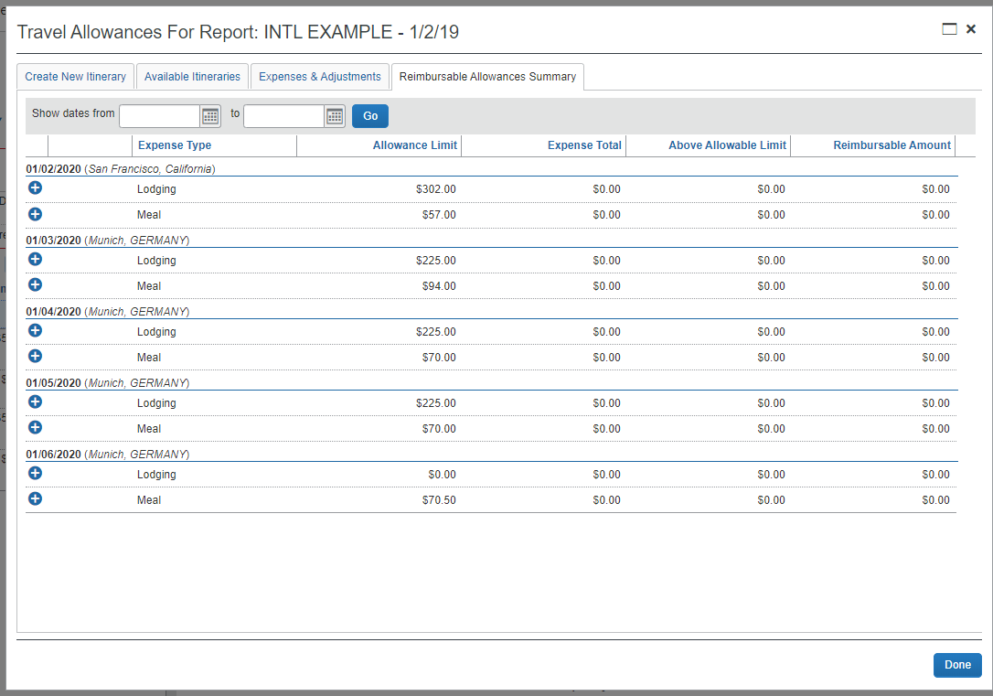
Travel allowance
Reimbursable Allowance Summary
AUTO-CALCULATES DAILY ALLOWANCES/ LIMITS:
Hotel and/or Meals & Incidentals expense type, day-by-day
GSO rates, auto-fed into Concur
Considers all countries traveled in or stopped at during trip
Limits are Do Not Exceed Total Amounts, Concur will not let you claim over the limit amount
Limits include all rates, fees, taxes, etc. (i.e. TOTAL hotel nightly expense –vs- nightly rate only)

Slide 19
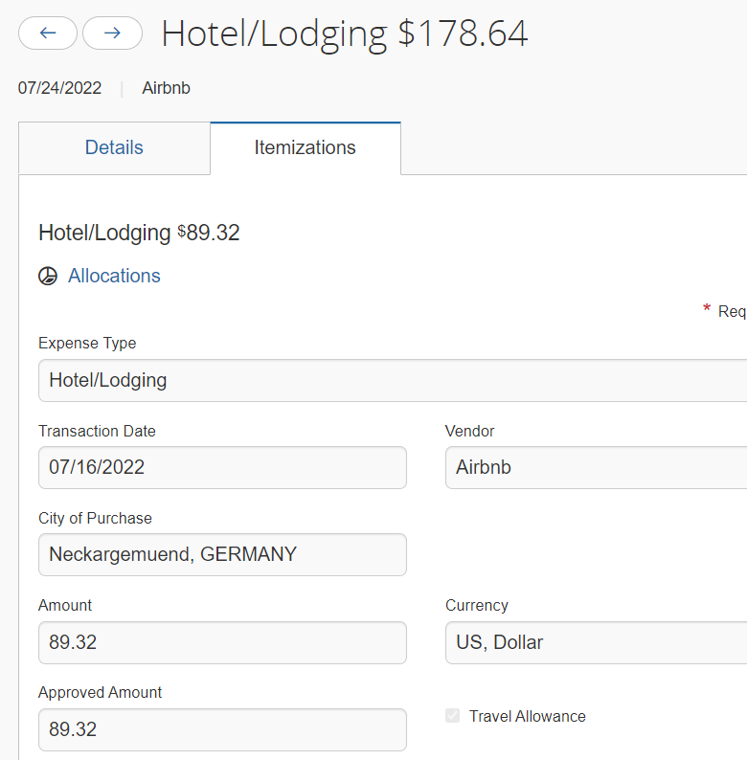
international Travel
Expense Types
When Travel includes Alaska, Hawaii or international destination(s)
Hotel: will need to check the Travel Allowance box in expense detail under Itemizations
Meals & Incidentals – International, Alaska, & Hawaii: Travel Allowance box will automatically be checked since this expense type is only for these destinations expense type must be used for all meals
All other expense types are the same as domestic travel

Slide 20
Questions

Slide 21
appendix

Slide 22
POLY TRAVEL APPROVAL FLOW - CONCUR
1.
Cost Object Approver
Budget & chartfield
string review
2.
Manager/Supervisor
Business need &
policy review
3.
Exception Approver
Banned state and/or International travel only
If same approver is in consecutive order, approval request will only go one time to approver’s queue
Cost Object Approver
Chartfield String
Time in Queue | If no action from approver, the system will
6 days | Automatically approve and it moves to HR manager
10 days | Automatically approve and it moves to HR manager
Manager/ Supervisor
Traveler
Time in Queue | If no action from approver, the system will
6 days | Automatically move to the next in-line manager
10 days | Automatically move to the next in-line manager
Exception Approver
Banned State or International
Time in Queue | If no action from approver, the system will
6 days | Automatically move to the next in-line manager
Request
Expense Report

Slide 23
CONCUR TRAVEL CARD
Benefits
Actual spend expensed –vs- claimed amount
Card transaction reflects what is actually paid
University liability, no financial burden to employee
Does not affect employee’s personal credit
Fraud protection
Travel insurance
Block inappropriate spend, based on merchant codes
Transaction feeds into Concur
Alerts users when there is a transaction on the card via email

Slide 24
Christopherson’s business travel
Benefits
Book travel online or via phone
ROI/ Cost Avoidance
Used ticket management – reuse used tickets
Avoid penalties: void or refund tickets
Enforcing negotiated contracts
Consolidate CSU spend. Leverage overall spend with travel vendors
Airlines only recognized spend managed by TMC for negotiations
Provide tools to locate Cal Poly travelers
24/7 Customer Support via phone for domestic or international travel
No “Group 9” (personal item only) fares loaded in Concur
Travel arrangements/ bookings and fees feed directly into Concur
Access to traveler’s profile

Slide 25
Cal poly travel guidelines

Slide 26
New Guidelines
All state employee travel to go through Poly Travel
Includes Sponsored Programs or grant travel (Corporation funded)
Concur Travel Card is the preferred method of payment for travel expenses
For all faculty and staff, regardless of frequency of travel
Claim actuals; per diems are allowance or do not exceed amounts
Only Concur Travel Card allowed in Concur profile
Travel expenses for individual card holder only
No cash advances, except rare instances or group travel with students
>

Slide 27
New Guidelines Continued
Christopherson’s Business Travel is Cal Poly’s preferred travel agency
Online (Concur Travel) or Phone
24 hours / 7 day support
International or Domestic
Direct bill to Cal Poly
CSU wide: manage and leverage spend
No “Group 9” airfare, unless requested
When traveling to a banned state approval must be obtained by each traveler’s VP regardless of funding source
Banned state travel using state funds requires written justification (COMMENT Section) on travel request that meets one of AB 1887 Exceptions
https://oag.ca.gov/ab1887
>

Slide 28
New Guidelines Continued
All individual-hosted hospitality can be paid via the Concur Travel Card
Regardless of location (25 miles within campus or during travel)
Expense non-travel hospitality monthly (one hospitality Expense Report per month)
Department events may still use department P-Cards
Hospitality policy applies and enforced
Domestic daily meal allowance is $55/ day¹, including…
Days of travel (outbound and return)
Conferences
EXCEPT, same day travel (24 hour travel), lunch expense is not permitted, therefore maximum daily allowance is $36.33. Amount claimed is taxable
>

Slide 29
New Guidelines Continued
Car rental for individual travel is required to be paid via Concur Travel Card
Direct bill is only available for non-employee travel (student or guest)
Only admins will receive PIN to book Enterprise cars via state portal
A Blanket Travel Request can be created for mileage and/or Hospitality only
Submit a monthly (or quarterly) Expense Report (only allowed to expense mileage 1X per month)
>

Slide 30
New Guidelines Personal and International travel
Personal Travel and International Travel requires itineraries
Itineraries clearly indicate days of personal travel – v.s. – university business travel (from outbound/ start date to return/ end date of travel), and locations when required
Itineraries required with Request and Expense Reports
>

