Slide 2
Clean up of “Legacy” Expense Reports with Actuals for meal expenses. New Meal Per Diem begins January 1, 2024
Concur Clean UP 2023 reports

Slide 3
AGENDA
Submitting Expense Reports for 2023 travel
How to read and review Concur Reports
Approved and Open with no Expense Report (including Closed Requests)
Unassigned Credit Card Transactions
How to become a Delegate
How to Reopen a Request
How to Create an Expense Report from an APPROVED Request
How to add an APPROVED Request to an already created Expense Report

Slide 4
Request Approved & Open with No Expense Report
Concur Report

Slide 5
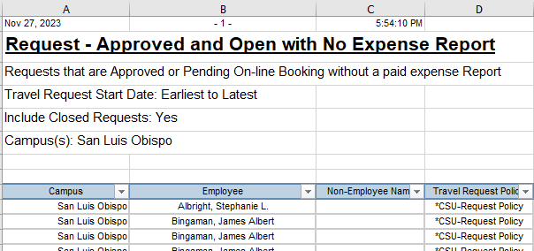
APPROVED AND OPEN WITH NO EXPENSE REPORT
The same report will be sent to all areas
Data is listed earliest to latest reports and includes CLOSED Requests*
Columns and their information:
* Closed Requests = 60 days past travel end date

Slide 6
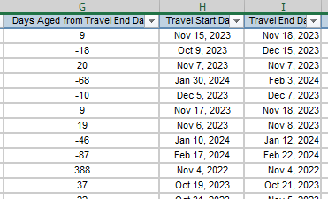
APPROVED AND OPEN WITH NO EXPENSE REPORT
Days Aged from Travel End Date: # of days that a request is open without an expense report.
Examples:
9 days: Travel ended Nov. 18th, so the days aged on Nov. 27th is 9 days
-18 days: Travel end date is Dec. 15th so the trip ends in 18 days
388 days: Travel end date was Nov. 4, 2022 so this Request has had no expense report for 388 days

Slide 7
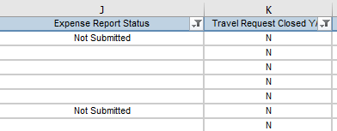
APPROVED AND OPEN WITH NO EXPENSE REPORT
Expense Report Status will be filtered to show:
“Not Submitted”
“Sent Back to User”
Blank fields*
All other statuses (“Pending Approval” & “Approved”) are not included as those reports have been submitted.
*Blank Fields = Expense Report not created

Slide 8
APPROVED AND OPEN WITH NO EXPENSE REPORT
Travel Request Closed Y/N: in this example, Column K has been filtered
To only show the Request that have not closed.
The Report will be sent to you with only open Requests.
The 2nd report (credit card charges) may be a trip with a closed Request.
Can filter to show both open and closed Requests to find the Request to reopen
How to reopen a Request will be shown later in this presentation.

Slide 9
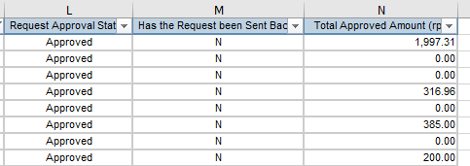
APPROVED AND OPEN WITH NO EXPENSE REPORT
All Requests have been Approved
If the request has been sent back to the traveler for corrections,
Column M would show “Y”
In this example, the requests on report have not been sent back.
Column N shows the total amount that was approved on the request
$0 may be “Liability/Unfunded Only” and can be closed without the need of an Expense Report.

Slide 10
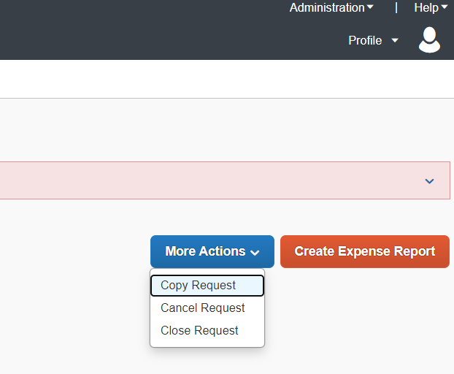
To Close a Request
Search for your travelers on the report by name
Filter “Days Aged” to show only reports with a positive number
If the Total Approved Amount is $0 and there were no expenses for the trip, you or the traveler can close
Click “Close Request” under “More Actions”

Slide 11
Create an Expense Report
If the Days Aged from the Travel End Date (Column G) is past and there is an approved amount (Column N):
Act as a Delegate and create a New Expense Report
OR
If a Report has already been created, Act as a Delegate and add the Approved Request to the already created Expense Report, then:
Make sure all receipts (or Lost Receipts) are attached
Check that all required documents are attached
Assist with hotel itemizations
Travelers can SUBMIT Expense Reports

Slide 12
Accrual of Unassigned and Unpaid Credit Card Charges
Concur Report

Slide 13
HOW TO READ UNASSIGNED CREDIT CARD CHARGES Report
Not Submitted: report has been created. May have alerts (no request attached, needs receipts, etc.) or may be ready to submit.
Pending Budget Approval: report has been submitted and is routing for approvals (will state which approval is next)
Unassigned: transaction is under “Available Expenses” in Concur and has not been added to an Expense Report yet
Approved & In Accounting Review: fully approved report. In Payment Services for processing.

Slide 14
HOW TO READ UNASSIGNED CREDIT CARD CHARGES Report
Payment Type: will be either CSU-USBank-CBCP for personal Concur Travel Card or Ghost Card-USBank for Airfare booked in Concur
Personal: Is this a personal expense?
N: it is not and has been assigned to an Expense Type on a Concur Expense Report.
Unassigned: has not yet been added to an Expense Report
Y: It is a personal expense and has been added to an Expense Report

Slide 15
HOW TO READ UNASSIGNED CREDIT CARD CHARGES Report
Travel Start Date
If there is no start and end date, an Expense Report has not yet been created
Transaction Date: date of actual charge on Concur Travel card or ghost card
Posted Date: date transaction posted to USBank and to Concur.
Merchants usually post transactions within 3-10 days, but some transactions can take up to 30 days to post (toll charges)

Slide 16
How to read Unassigned Credit Card Charges Report
Business Unit
Cal Poly is SLCMP
Account Code is added from Concur and cannot be changed by a traveler or department
Column Q,R,S,T,U – Chatfield String added by the traveler in Concur
Transaction Age (in months): How many months the charges have been in Concur?

Slide 17
ACTION – CREDIT CARD REPORT
Make sure you received all your departments chartfield strings. If not, email PolyTravel for the full list
Note: you will only receive list of Dept ID’s that have been used for travel in Concur
Filter Approval Status to review the “Unassigned” and “Not Submitted” charges
Compare report with travelers Concur Expense page and assist with adding charges to a report (Unassigned)
Clear alerts so the report can be submitted (Not Submitted)
Have the traveler Submit the Expense Report

Slide 18
HOW TO BECOME A DELEGATE
Concur

Slide 19
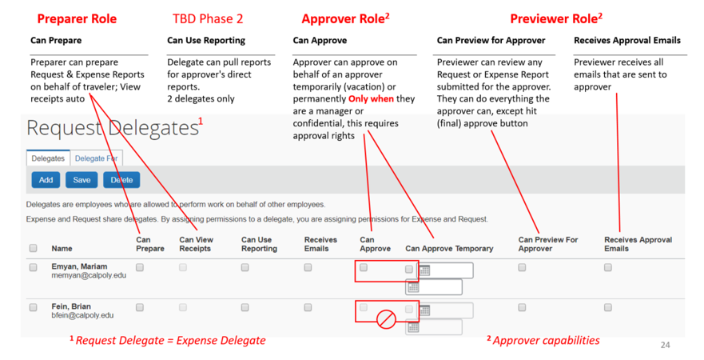
HOW TO BECOME A DELEGATE
A delegate can: review credit card charges, prepare Expense Reports, add receipts and comments on behalf of a traveler.
To be added as a delegate, ask the traveler to add you as a delegate (Profile/Profile Settings/Request Delegate) or contact Poly Travel.

Slide 20
HOW TO REOPEN A REQUEST
Concur

Slide 21
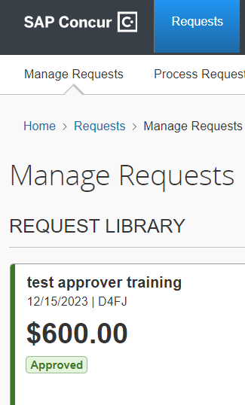
REOPEN AN APPROVED REQUEST
Email Poly Travel to reopen an approved request.
polytravel@calpoly.edu
Provide the traveler name, Trip Name, and 4 digit Request ID

Slide 22
HOW TO CREATE EXPENSE REPORT FROM AN APPROVED REQUEST
Concur

Slide 23
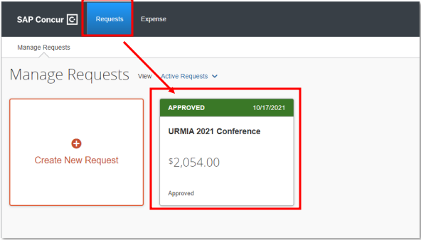
HOW TO CREATE EXPENSE REPORT FROM AN APPROVED REQUEST
Click the “Requests” header
Select the tile for the specific trip request to open your approved travel request
Then click “Create Expense Report” to start the report

Slide 24
HOW TO ADD A REQUEST TO ALREADY CREATED EXPENSE REPORT
Concur Report

Slide 25
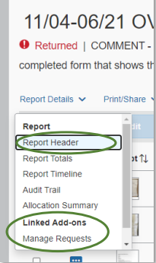
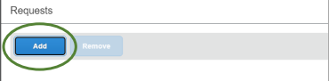
HOW TO ADD A REQUEST TO ALREADY CREATED EXPENSE REPORT
Open the Expense Report and click “Report Details” then “Manage Requests”
A popup will appear. Click “Add”

Slide 26
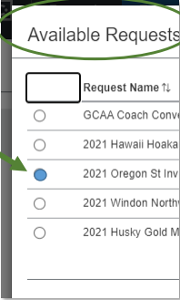
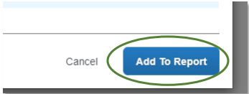
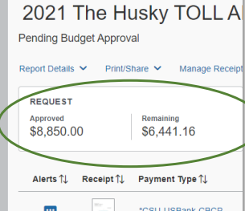
HOW TO ADD A REQUEST TO ALREADY CREATED EXPENSE REPORT
Select the available approved requests to attach to the expense report and click “Add to Report”
Note: Only approved requests will be available
The approved request will show at the top of the Expense Report in a box titled “Request”

Slide 27
Appendix

Slide 28
Website Resources & GUides https://afd.calpoly.edu/travel/resources/

