Slide 1
CSU TRAVEL POLICY UPDATES 2024
POLY TRAVEL | DECEMBER 6th, 2023

Slide 2
Agenda
TODAY WE WILL COVER…
Domestic meal per diem
$75 receipt requirement
Horizon Fiori for Concur
15 passenger vans
Paying back the university
Concur approver training
Credit card infractions
Other CSU updates

Slide 3
Travel Policy Updates
AN OVERVIEW
The CSU updated its travel policy
Major change: Domestic meals & incidentals are changing from actuals to per diem
Domestic hotels & international travel remains the same
Cal Poly is taking this opportunity to update its own travel policies

Slide 4
Policy Implementation
WHAT YOU SHOULD KNOW
Changes are effective January 1st, 2024
Available on the CSU Policy Library
Affects travel with a start date of January 1st, 2024 or later
Travel with a start date prior to January 1st, 2024, shall be expensed based on current policies
Deadline to submit Expense Report: January 31st, 2024

Slide 5
BEFORE
2 expense types
Meals
Actuals
Daily limit: $55
Receipts required for $40+ purchases
Incidentals
Actuals
Daily limit: $7
AFTER
1 expense type
Meals & Incidentals (M&IE)
Per diem
No receipts required
Per diem range
5 amounts between $59 & $79 based on location
75% 1st & 2nd day of travel

Slide 6
GSA M&IE Breakdown
5 per diem amounts
Provides a value for each meal
Displays first & last day of travel
Up to 75% of each day
M&IE Total | Continental Breakfast/Breakfast | Lunch | Dinner | Incidental Expenses | First & Last Day Of Travel
$59 | $13 | $15 | $26 | $5 | $44.25
$64 | $14 | $16 | $29 | $5 | $48.00
$69 | $16 | $17 | $31 | $5 | $51.75
$74 | $17 | $18 | $34 | $5 | $55.50
$79 | $18 | $20 | $36 | $5 | $59.25

Slide 7
Per Diem Types
EMPLOYEE TRAVEL
Location-based per diem according to GSA rates
Rates are automatically updated in Concur
The amount is higher for cities with higher cost-of-living
NON-EMPLOYEE TRAVEL
$59 fixed rate per diem
Advantages:
It is easy to communicate to non-employees
Decreases data entry & review time for users
Non-employee travel policies are loaded in Concur
Paper claim on Microsoft Excel

Slide 8
EMPLOYEE TRAVEL

Slide 9
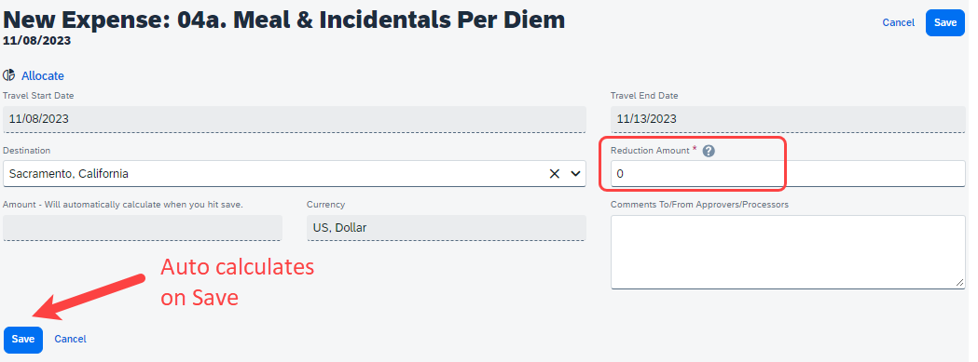
Domestic Location
SUBMIT A NEW EXPENSE REQUEST
Enter “Travel Start Date”, “End Dates”, and “Destination”
Concur will automatically calculate the estimate amount based on the location

Slide 10
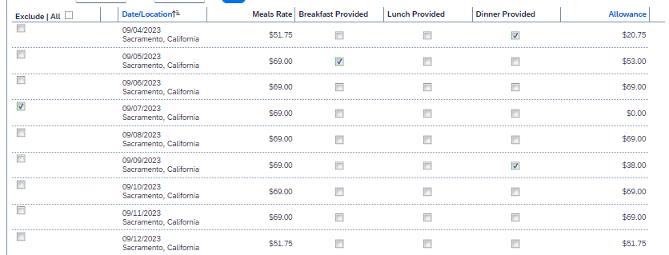
Travel Allowance Itinerary
The traveler enters dates & locations
Concur will separate each day into its own line
Daily per diem
Reductions based on meals provided to the traveler
75% of the starting amount

Slide 11
Concur Card Charges
When the Concur card is used, the university directly pays the vendor
The per diem amount is what is owed to the traveler
Per diem is claimed in the same way
Concur card transactions will be expensed separately using the “Meals Charged on Campus Issued Card” expense type
Reduces the amount owed to the traveler
Each transaction related to meals need to be claimed & expensed

Slide 12
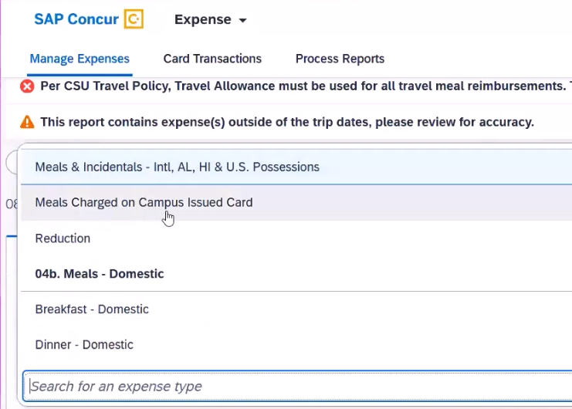
Concur Card Charges
ADDING AN EXPENSE

Slide 13
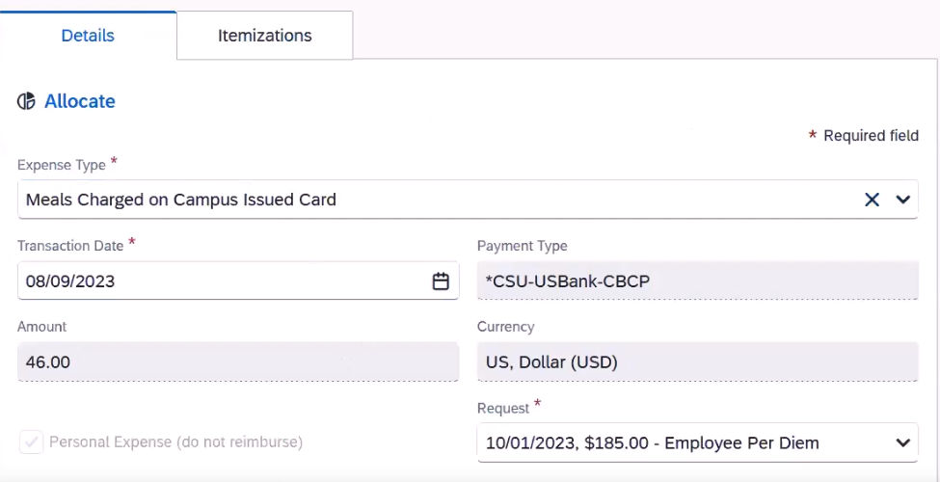
Concur Card Charges

Slide 14
Concur Card Charges

Slide 15
Reductions
A REDUCTION IS MADE WHEN:
The department approves a lower per diem than the location per diem
For example, the department approves a per diem of $59 when the location per diem is $79
The per diem amount in the system is what is owed to the traveler
The traveler can reduce the per diem to an approved amount in the system

Slide 16
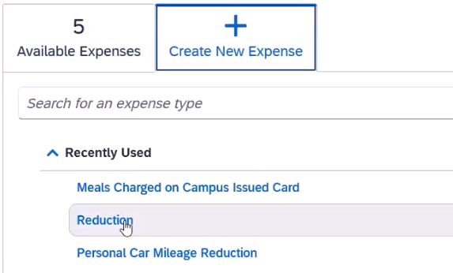
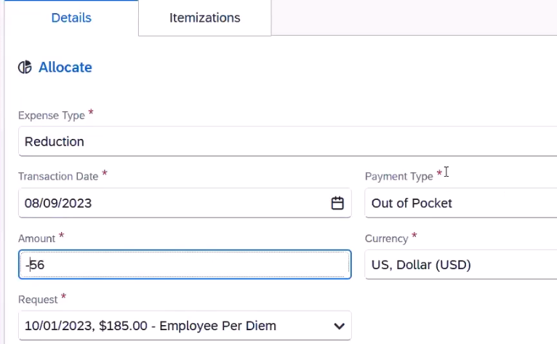
Reductions
ADDING A REDUCTION
Per diem amounts cannot be changed but can be reduced by the amount that will be reimbursed (in the case of limited funding)
Add a negative amount

Slide 17
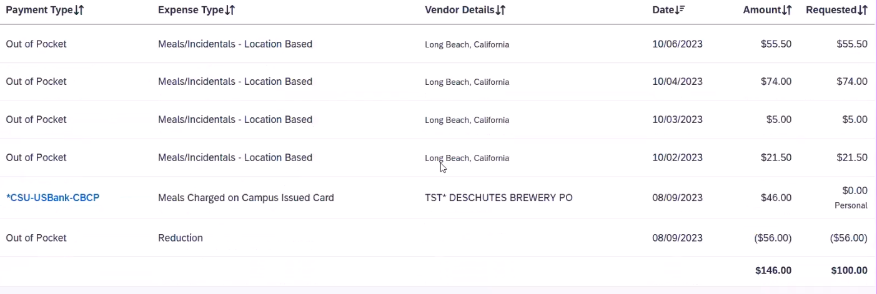
Reductions
Shows under “Amount” as a negative “Out of Pocket” amount

Slide 18
NON-EMPLOYEE TRAVEL

Slide 19
EXPENSE REPORTS
Guest (Prospective employees, non-degree candidates, volunteers, & foreign visiting scholars)
Departments can book and claim travel on their behalf
Use the non-employee expense policy
Individual Student
Use the updated paper claim
Travel allowance itineraries are not required
Receipts are not required
Flat $59 per diem

Slide 20
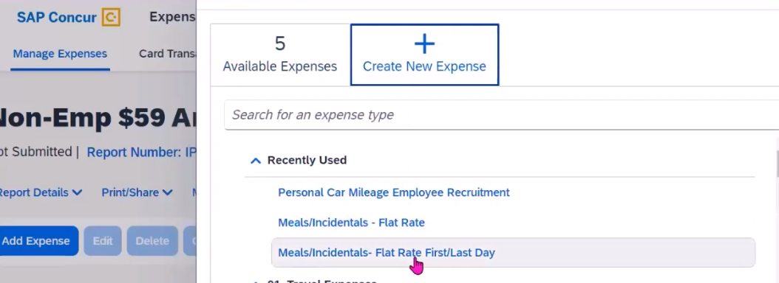
EXPENSE REPORTS
USING THE NON-EMPLOYEE POLICY
“Meals/Incidentals - Flat Rate” added for each full day
“Meals/Incidentals – Flat Rate First/Last Day” added for first and last day of travel

Slide 21
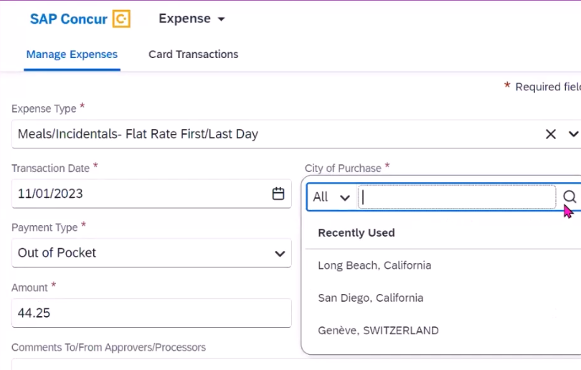
EXPENSE REPORTS
ENTERING FLAT RATE FOR THE FIRST & LAST DAY
Enter “Transaction Date”
Enter “City of Purchase
Enter 75% of the $59 flat rate, $44.25

Slide 22
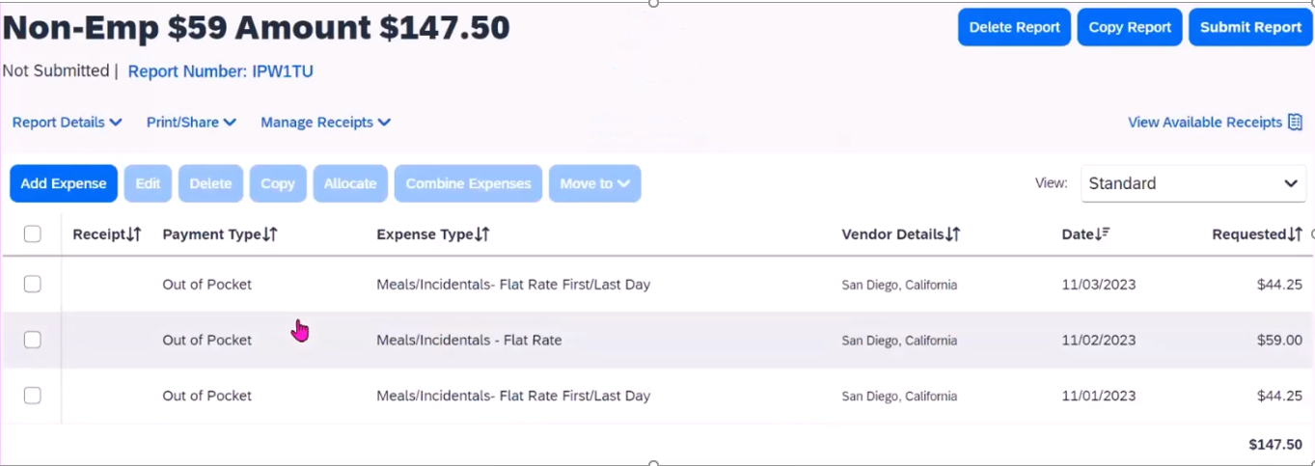
EXPENSE REPORTS
EXAMPLE OF 3-DAY GUEST VISIT

Slide 23
$75 RECEIPT REQUIREMENT

Slide 24
REQUIREMENTS
Hospitality, airfare, hotel, and car rental expenses will always require an itemized receipt regardless of the amount
All other expenses (ex: ground transportation, parking tolls, etc.) only require receipts with amounts of $75+
All transportation must have a comment stating the starting and ending destination (ex: Uber from the airport to the hotel)
Individual travel meals on the Concur card will not require a receipt because meals are per diem

Slide 25
CONCUR NEW LOOK

Slide 26
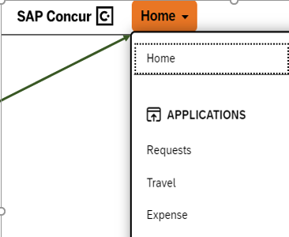
HORIZON FIORI
Navigation settings have been updates and are available under home
No changes to the features or functionality
4 visual options

Slide 27
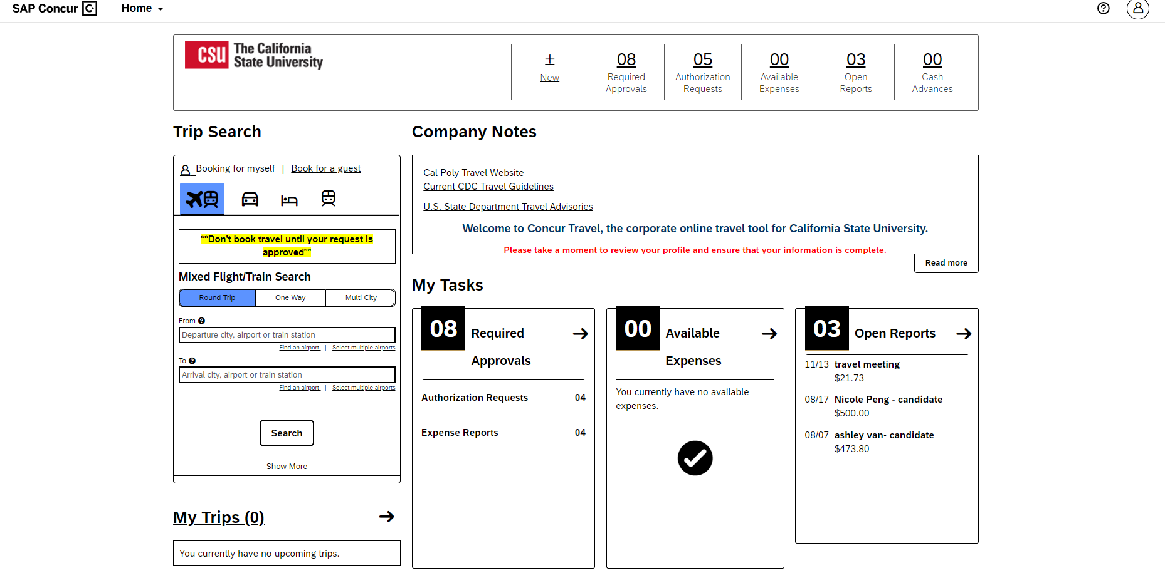
HORIZON FIORI

Slide 28
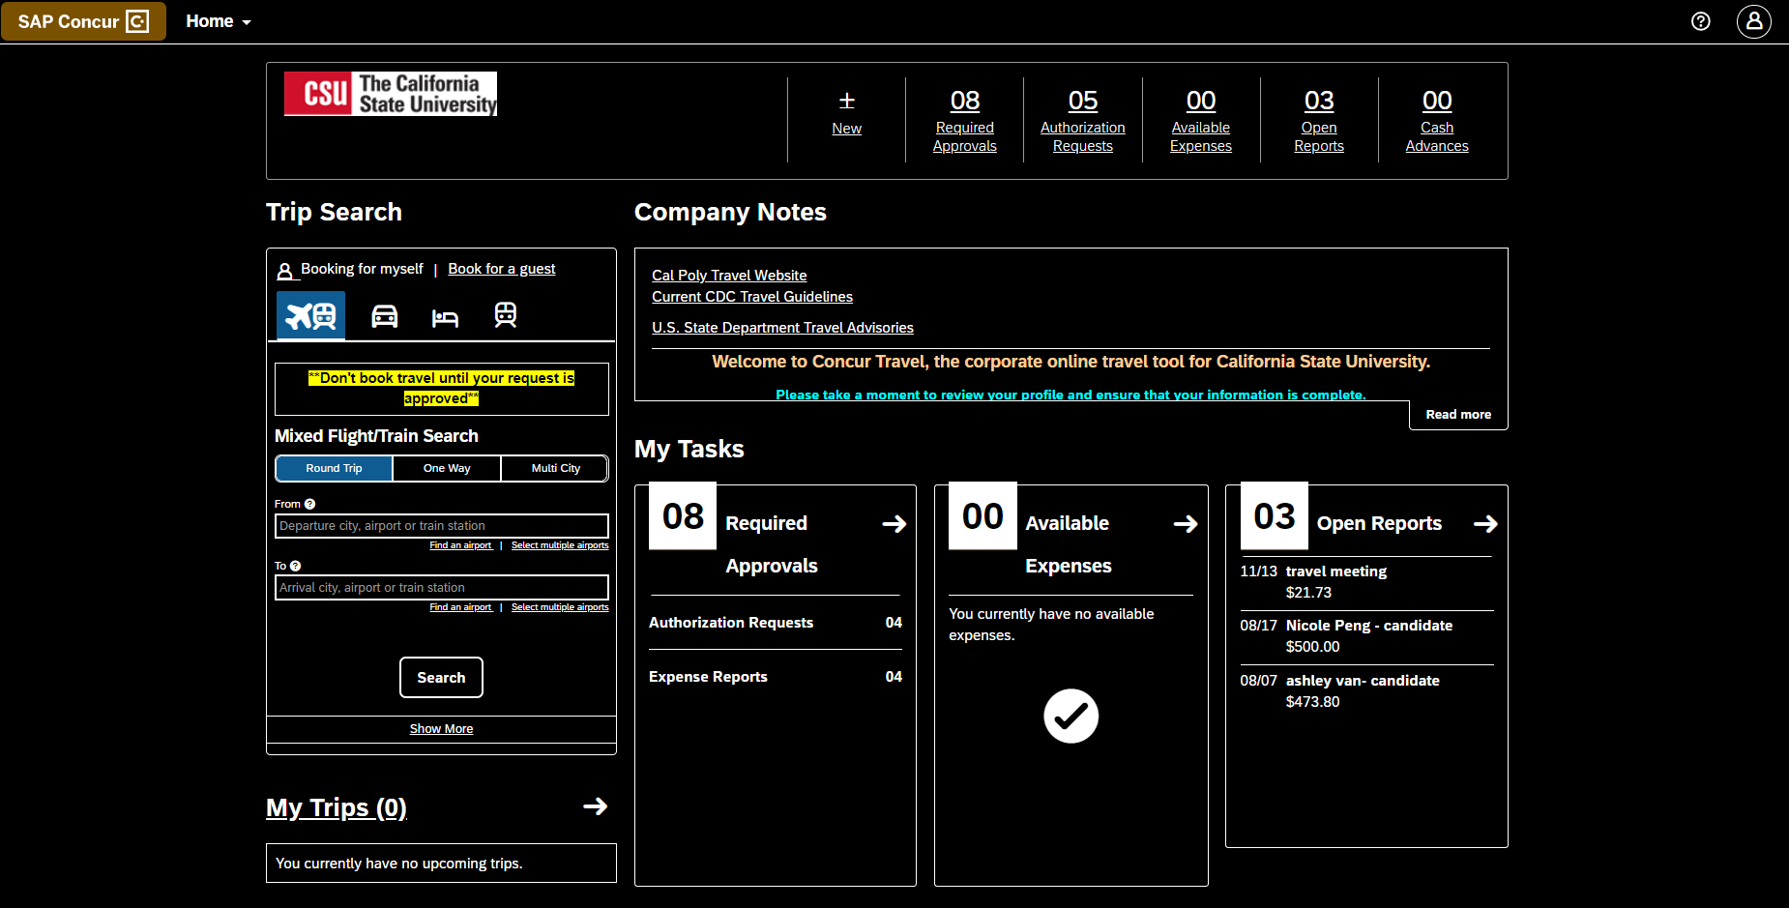
HORIZON FIORI

Slide 29
PAYING BACK THE UNIVERSITY

Slide 30
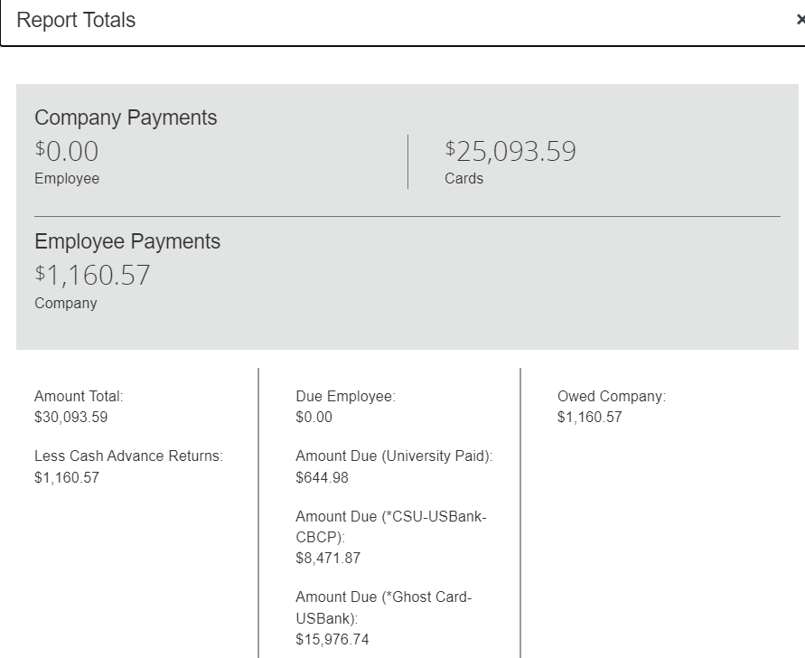
PAYING BACK THE UNIVERSITY
PAYING BACK CASH ADVANCES & PERSONAL/NON-REIMBURSABLE EXPENSES
Complete the expense report
Review report totals from the expense report
Pay back the required amount to the Cashier’s Office. Show a screenshot of the report totals page
Attach the Cashier’s Office receipt to the expense line item
Submit the expense report

Slide 32
OTHER CSU UPDATES

Slide 33
Other CSU Updates
Conference hotels
A traveler who attends a conference where the prearranged lodging rate exceeds the $275 per night limit must stay at the conference hotel without additional approval
Must add “Approved conference hotel” in the comment section
Temporary work assignments
Lodging reimbursement shall be reduced by any amount received for renting out the traveler’s primary residence
Non-employee travelers
Includes prospective employees, students, non-degree candidates, volunteers, foreign visiting scholars, spouses, and registered domestic partners

Slide 34
15 PASSENGER VANS

Slide 35
15 Passenger Vans
Rentals are prohibited for travel
Drivers of 15-passenger vans must:
Have the correct license and endorsement
Go through Risk Management’s Driver Safety program
To learn more about the requirements, please contact Risk Management or email driversafety@calpoly.edu

Slide 36
NEW INFORMATION

Slide 37
Concur Approver Training
All travel approvers will be required to take an annual training online
The initial training will be sent in January with 30 days to complete
Allows for more efficient process with Payment Services

Slide 38
Credit Card Pick-up Location
The Pro Card and Concur Travel Card pick-up is moving to the Cashier’s Office on January 1st, 2024
The Pro Card administrator will email the cardholder when the card is ready for pick-up
Be sure to bring an ID to pick-up the card

Slide 39
Credit Card Violations & Corrections Procedures
Misuse of the travel card according to procedures manual can lead to deactivation until the issue is resolved and retraining is completed
Violations include (but not limited to):
Late submission of expense reports (30+ days past trip end date)
Missing receipts or non-itemized receipt
Personal purchases
Missing hospitality forms
Unauthorized transactions

Slide 40
Credit Card Violations & Corrections Procedures
If a cardholder incurs three (3) violations within a fiscal year, they will have their Concur Travel Card deactivated
First Offense: Email to Cardholder and Approving Official with 1 week to remedy the violation
Second Offense: Email to Cardholder and Approving Official, warning of card suspension
Third Offense: Email to Cardholder, Approving Official and Department VP or Dean. Card suspended for at least 1 billing cycle and retraining required.

Slide 41
APPENDIX

Slide 42
Moving & Relocation
Offer letters dated November 1st, 2023: allowance
Offer letters dates prior to November 1st, 2023: reimbursement
New employees have 12 months to claim their moving and relocation

Slide 43
Review Federal Per Diem Websites
Review Federal Per Diem websites
Continental United States (CONUS)
Domestic Meals and Incidental Expenses (M&IE) U.S. General Services Administration (GSA)
Outside the Continental United States (OCONUS)
Alaska, Hawaii, and US territories US Department of Defense
International Meals and Incidentals U.S. Department of State

Slide 44
THANK YOU

